Slide 1
Building Successful Collaborations Through Integrated Programs

Slide 2
Session Overview
Overview of the Homeless Initiative and Measure H Strategies
Integrated Care Model in
Permanent Supportive Housing
A Case Study at the Arlington Apartments

Slide 3
Leading Causes of Homelessness
Insufficient income and lack of affordable housing are the leading causes of homelessness (National Law Center on Homelessness & Poverty)
California Housing Partnership Corporation found an affordable housing gap in Los Angeles County of 527,000 units in 2015 Study.
According to the National Law Center on Homelessness & Poverty, the top (5) causes among homelessness among individuals include:
Lack of Affordable Housing
Unemployment
Poverty
Mental Illness & lack of needed services
Substance Abuse and lack of needed services

Slide 4
Homeless Initiative Overview
On August 17, 2015 the County launched an effort to develop a comprehensive set of recommended County strategies to combat homelessness.
Inclusive and collaborative planning process involving over 1,100 experts and community members focused on what works, 18 policy summits, 4 focus groups with people who are homeless, 2 community meetings, over 200 public comments.
On February 9, 2016, the LA County Board of Supervisors adopted a coordinated set of Homeless Initiative 47 strategies to combat homelessness, including strategies in which cities, businesses and faith leaders can participate.
New one-time funding approved: $99.7 million

Slide 5
Measure H - Ballot Initiative
December 2016 – LA County Board of Supervisors approves ordinance placing Measure H on the ballot – a ¼ cent County sales tax that will generate an estimated $355 million annually for 10 years, solely to prevent and combat homelessness.
March 2017 - County voters approve Measure H, with 69.34% favoring landmark measure.
February 2017 – LA County Board of Supervisors directs the Chief Executive Office to conduct an inclusive, collaborative and public Measure H Revenue Planning Process and report back with recommendations.

Slide 6
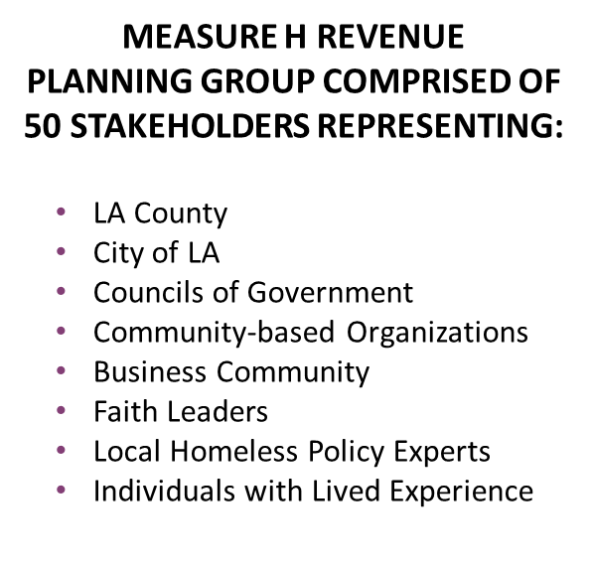
Measure H - Revenue Planning Process

Slide 7
Homeless Initiatives Strategies: Continuum of Services
Outreach – E6
Interim/Bridge Housing – B7/E8
Rapid Rehousing – B3
Permanent Supportive Housing – D7
Benefits Advocacy – C4/C5/C6
Strengthening the Coordinated Entry System – E7

Slide 8
Ensuring the Right Level of Services are Available Countywide – Overview of Integrated Services in D7
Intensive Case Management Services
DMH
Housing Full Service Partnership
DHS
ICMS services are based on a whatever it takes approach so they are comprehensive and tailored for each client.
Obtaining necessary documentation
Completing and submitting rental subsidy application
Housing search
Eviction prevention support and intervention
Ongoing client support and home visits
Making and keeping appointments for health, mental health and SUD services
Transportation
Ensuring access and enrollment in health and income benefits
These services will help clients manage the symptoms of their mental illness and will assist them with their mental health wellness and recovery goals.
Services include:
Individual/Group Therapy/Counseling
Medication Support
Crisis Intervention
Referrals and Linkage
DHS
Provision of Additional Funding for PSH sites
DPH
Substance Use Disorder Services
Community Engagement and Navigation Services includes outreach and engagement, screening and referral, SUD service navigation, and care coordination to improve access to SUD services
Field Based Navigation Services includes outpatient and intensive outpatient SUD services, including individual and group counseling
D7 includes a $7.5 million annual flexible allocation that can fund
Additional new permanent supportive housing
Services in existing permanent supportive housing that have had insufficient services funding
Local rent subsidies if projections for federal subsidies are not realized
All services are provided by community based service providers through contracts with each department listed above

Slide 9
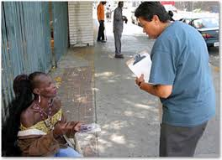
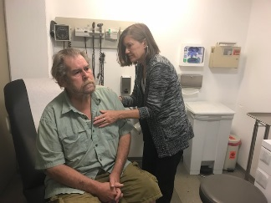
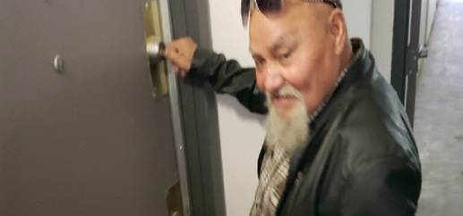
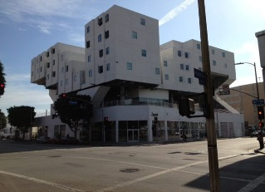
Best Practices in ICMS
Housing First
Connect people experiencing homelessness to permanent housing without preconditions or barriers to entry
Harm Reduction
Harm reduction is a set of practical strategies and ideas aimed at reducing negative consequences associated with drug use.
Whatever it Takes
Whatever it Takes is a flexible approach to service delivery for people who are experiencing homelessness or are living in permanent supportive housing and dealing with mental illness, chronic health conditions and or substance use disorders.

Slide 10
Core Functions of ICMS
Outreach and Engagement
Intake and Assessment
Addressing Immediate
Client Needs
Interim Housing
Permanent Housing Search
Move-In Activities
Supports/Linkages/Retention
Notes:
Joey

Slide 11
What does whatever it takes mean in ICMS?
1
(1) Go above and beyond “How are you feeling today?”
2
(2) Ensure clients are maintaining medication and treatment regimens.
(3) Ensure linkage to health, mental health services and specialty care.
4
3
(4) Provide a range of services such as, transportation to ensure linkages are made to other necessary services
Monitor and follow-up with clients and communicate clients needs

Slide 12
Integrating Substance Use, Mental Health, and Primary Care Services in Our Communities: Arlington Square

Slide 13
8 Core Integrated Services
Housing
Mental Health Care
Benefits & Income
Domestic Violence Services
Medical Care
Addiction Treatment
Wellness & Life Skills
Outreach & Engage-ment

Slide 14
ARLINGTON SQUARE
Population
Project Based Permanent Supportive Housing
TPC is providing ICMS and Housing FSP services on site
Leased up in August 2017
46 units
Mixed population –
Veterans
High Utilizers of DMH and DHS
HOPWA

Slide 15
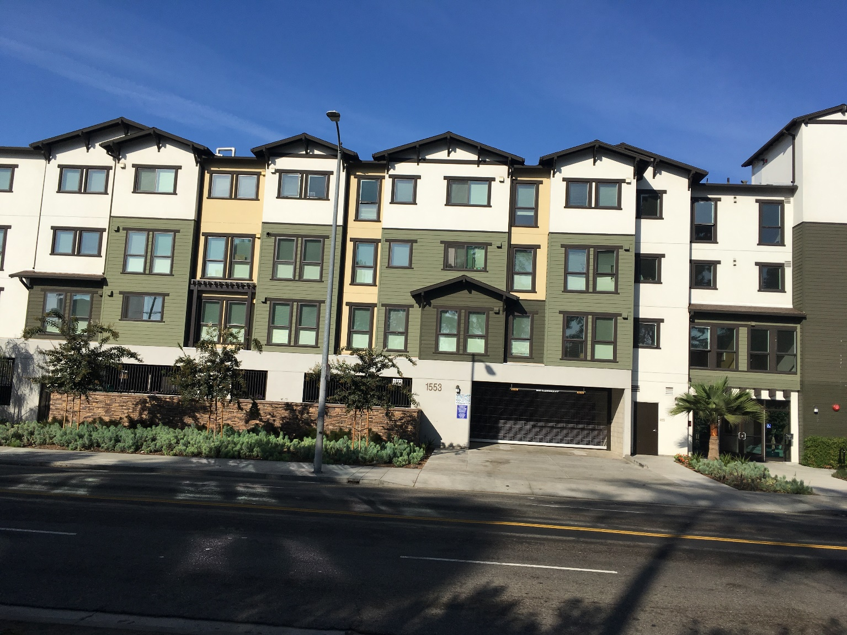
ARLINGTON SQUARE

Slide 16
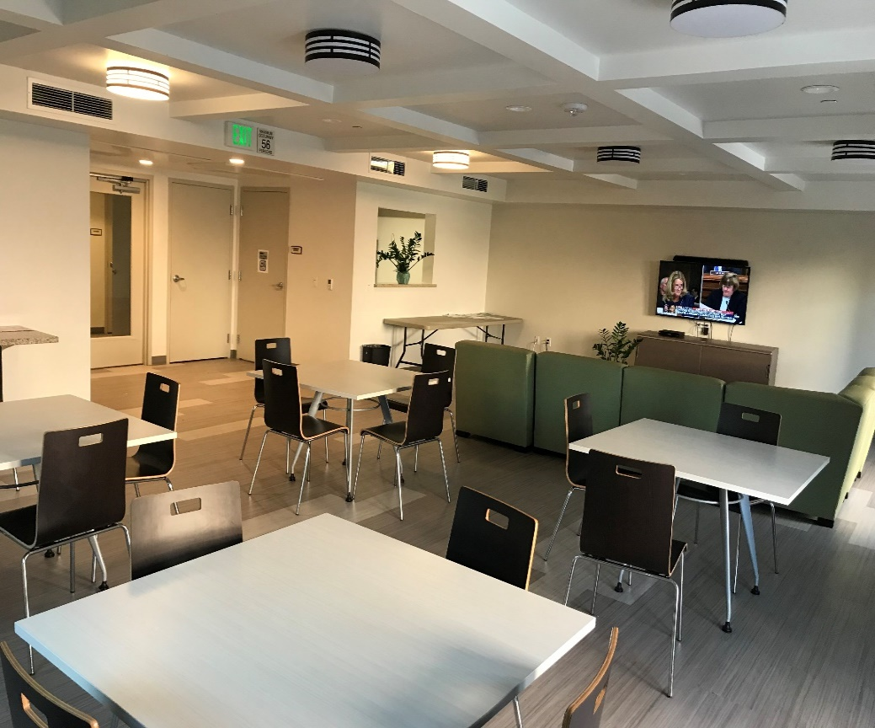
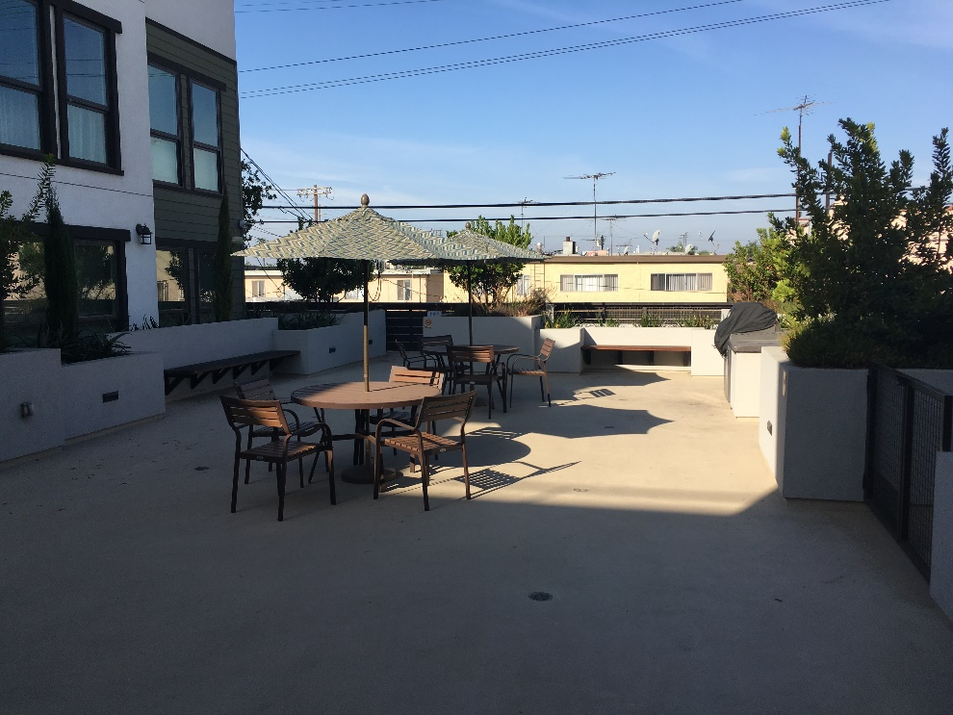
ARLINGTON SQUARE
Developer: ACOF
Location: Venice and Arlington Ave
Property Management: Barker

Slide 17
ARLINGTON SQUARE
BEFORE INTERGRATED SERVICES
2 Case managers only providers on site
In first 6 months – 24 hospitalizations, most were psychiatric
2 incarcerations
2 situations in which staff found tenants deceased in apartment
2 restraining orders against friends entering unit without permission - destroying unit

Slide 18
ARLINGTON SQUARE
With Integrated Service Onsite
ICMS is present full time onsite
Housing FSP– psychiatrist onsite weekly
CENS (Client Engagement and Navigation Services) on site weekly
The VALOR program is also on site weekly to provide mental health services to Veterans
DHS HFH Nurse –doing psychoeducation around medical symptoms and connection to Primary Care Services.

Slide 19
ARLINGTON SQUARE
NOW
Have easy access to a psychiatrist which has increased interest in discussing medication
One client agreed to Vivitrol to treat substance use disorder
One individual that was incarcerated due to his SPMH was transferred from Jail to hospital and discharged on injectable medication
DHS Nurses are doing home visits to ensure medication management and assist in connection to Primary Care Services.

Slide 20
Case Study/Examples
35 year old Caucasian female – Dually Diagnosed
Placed in project – transitioned well
Following period of stability, client experienced recurrence of substance use
Co-location of intensive Case Management and Substance Abuse Outreach Services supported smooth and easy connection to treatment
Has managed to stay housed for over 1 year

Slide 21
Integrating Housing
Populations
Integrating Populations can mean many things
Special needs and affordable
Veteran and high utilizers
Families and individuals
Developers, Property Management, and Services Providers set the stage and have big impact on positive integration
Must show that they are integrated and unified in their approach
Need to have regular collaborative meetings
All present at community meetings

Slide 22
STAFF WEAR MULTIPLE HATS
Liaison with Property Manager
HOUSING
SPECIALIST
CASE
MANAGER

Slide 23
LESSONS LEARNED
Be cognizant of location of services offices within the project
Make sure to use language that does facilitate integration.
All populations can attend all activities and so on………..
Services providers at property need to communicate/collaborate – defining roles is integral

Slide 24
Substance use disorder
CLIENT ENGAGEMENT AND NAVIGATION SERVICES
Presented by: Yanira A. Lima MPA, MHM
Chief, Adult Systems of Care
Los Angeles County Department of Public Health
Substance Abuse Prevention and Control (SAPC)

Slide 25
CENS in Permanent Supportive Housing
By: David Murillo

Slide 26
CLIENT ENGAGEMENT AND NAVIGATION SERVICES
CENS is the former Community Assessment Service Centers (CASC)
Serves as one of the entry points into the County’s SUD system of care
Targets County/City-involved individuals who are homeless or have criminal justice issues or a co-occurring disorder
Provides face-to-face services to facilitate access to and completion of SUD treatment
CENS offices are staffed by registered and/or certified SUD counselors
CENS staff must comply with confidentially requirements set forth in Title 42, Code of Federal Regulation (CFR) and the Health Insurance Portability and Accountability Act (HIPPA) of 1996

Slide 27
CENS is comprised of Eight (8) Community Based Organizations in each of the eight (8) Service Planning Areas (SPA)
SPA | Agency
SPA 1 | Tarzana Treatment Centers
SPA 2 | San Fernando Valley Community Mental Health Center
SPA 3 | Prototypes
SPA 4 | Homeless Health Care Los Angeles
SPA 5 | Did Hirsch Mental Health Services
SPA 6 | Special Services for Groups Homeless Outreach Program Integrated Care System
SPA 7 | California Hispanic Commission on Alcohol and Drug Abuse
SPA 8 | Behavioral Health Services

Slide 28
CENS Locations
CENS are co-located at various government and community sites:
Department of Children and Family Services Regional Offices
Department of Mental Health Psychiatric Urgent Care Centers (UCC) and Psychiatric Emergency Departments
Health Facilities (e.g., public and private Emergency Departments and FQHCs)
Homeless Encampments
Permanent Supportive Housing (PSH) sites
Los Angeles Superior Court (e.g., Antelope Valley, Criminal Courts Building, Compton, Pasadena, Van Nuys)
Probation Department (e.g., Assembly Bill 109 HUBS and Adult Area Offices)
Sheriff’s Department (e.g., Twin Towers Correctional Facility)

Slide 29
CENS Core Activities
Client Outreach and Engagement
Client Eligibility and Enrollment
Client Education
Client Screening, Appointment Scheduling, Reminders and Follow-up
Service Navigation, Ancillary Referrals and Linkages
Documentation and Reporting
Agency and Community Education

Slide 30
CENS Overview
The key goal of CENS is to provide integration and coordination of care by:
Providing substance use screenings
Referrals to Outpatient, Residential, and Detox services
Verifying Medi-cal eligibility and assisting individuals to enroll in Medi-cal or My Health LA
CENS utilizes evidence based methodologies (e.g., Motivational Interviewing) to engage, motivate and educate clients on:
Behavioral Changes
Substance Use Disorders
Coping Strategies
HIV/AIDS Education
Naloxone Overdose Prevention
Relapse Prevention
Medication – Assisted Treatment for Alcohol and Opioid Use Disorders

Slide 31
Overview Continuation
CENS screens clients using the ASAM Triage to determine a client’s provisional level of care and to schedule an intake appointment with a treatment facility.
CENS provides wraparound services, such as:
Appointment reminders and follow-ups
Coordinating and providing transportation to treatment
Serve as a liaison between the treatment facility and client to remove any barriers preventing clients from enrolling in a program.
For clients who do not make it to treatment, CENS staff provides harm reduction interventions, such as:
Substance use education
Education on local needle exchange programs
Overdose prevention
Medication Assisted Treatment options

Slide 32
HOW Measure H Funding IS utilized FOR D7
Through Measure H funding of Homeless Initiative (HI) Strategy D7: Services and Rental Subsidies for Permanent Supportive Housing (PSH).
CENS providers provide services at project-based and scattered PSH sites that include:
Outreach and engagement services to residents in permanent supporting housing.
Provide SUD screening and referral to SUD treatment services.
Funding supports the co-location of CENS at selected permanent supporting housing facilities.

Slide 33
ROLE OF CENS IN D7
Services at project-based and scattered PSH sites:
Services are intended for individuals who exhibit signs of SUD or have relapsed to prevent their eviction from housing
Approximately one-third of HI Strategy D7 participants will receive CENS services

Slide 34
SERVICES CENS WILL PROVIDE
CENS Staff will participate in tenant meetings to promote CENS and SUD services
Provide SUD education to tenants and staff
Conduct SUD outreach and engagement by using motivational interviewing techniques to encourage SUD screening
Include linkages to SUD treatment providers

Slide 35
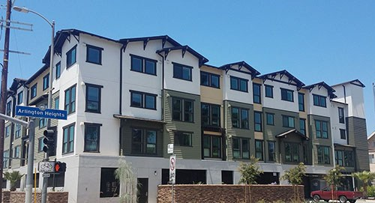
PERMANENT SUPPORTIVE HOUSING & CENS Arlington Square
CENS staff are now co-located at Arlington Square
CENS Services provided onsite:
Residents can receive SUD screenings and referrals to treatment
Substance use education
Community Meetings
Field-Base Services coming soon:
Substance use treatment groups
Individual substance use counseling

Slide 36
SUD SYSTEM OF CARE BENEFITS
Drug Medi-Cal - Organized System of Care expanded the available services to patients in order to create a fuller continuum of care.
Old DMC-SUD System | New DMC-SUD System for Youth and Adults
☑ Outpatient ☑ Intensive Outpatient ☑ Residential (Perinatal Patients Only) ☑ Opioid Treatment Program ☑ Individual Sessions (Crisis Only) ☑ Group Sessions | ☑ Outpatient ☑ Intensive Outpatient ☑ Residential (All Populations – 3 Levels of Care) ☑ Opioid Treatment Program ☑ Additional Medication-Assisted Treatment ☑ Withdrawal Management (Detox) ☑ Individual Sessions (No Limits) ☑ Group Sessions ☑ Family Therapy ☑ Case Management/Care Coordination Recovery Support Services Field-Based Services Recovery Bridge Housing

Slide 37
BENEFITS FOR HOMELESS INDIVIDUALS
START-ODS expands the available services to homeless patients in order to address their homelessness status.
Recovery Bridge Housing
Type of abstinence-based, peer supportive housing that provides a safe interim living environment
Aimed at patients who are homeless or unstably housed while receiving treatment in outpatient, intensive outpatient, opioid treatment program or outpatient withdrawal management
Stays of up to 90 days
500 beds funded by Measure H
250 beds funded by other non-DMC funds

Slide 38
BENEFITS OF CENS AT ARLINGTON SQUARE
CENS staff available on-site to reduce barrier to accessing treatment
Individualized attention
“Meeting clients where they are”
Clients interviewed in their own environment
Direct linkages to mental health, substance use services and other services
Ongoing psychoeducation
Support housing retention

Slide 39
THE CHALLENGES
Limited resident engagement
Fear of losing their housing for substance use
Lack of education around substance use options and maintaining housing
Mental health compliance can be a barrier to accessing substance use treatment

Slide 40
SOLUTIONS TO INCREASE PARTICIPATION
Harm Reduction on-site group
Food (i.e., donuts, coffee) during groups
Incentives
Bus tokens for transportation

Slide 41
A SUCCESS STORY
Pauletta began working with a client at Arlington for the past month. First gaining trust and developing rapport, client was interested in being screened and expressed a need for residential treatment. During screening and through motivational interviewing, client disclosed not being medication compliant for her chronic mental conditions. Client scored a provisional level of care indicating co-occurring residential treatment would be the most appropriate, therefore, requiring client to be medication compliant. Pauletta encouraged client to visit her Primary Medical Provider and Mental Health Specialist for medical refills. After Pauletta’s follow-up, client successfully obtained her medical, but not her mental health medication. Pauletta referred client to a Mental Health Urgent Care near her area, provided transportation directions, to expedite the process. Client emailed Pauletta informing her that she successfully obtained her mental health medication. Pauletta then contacted a residential treatment facility and successfully secured an intake appointment for the client, and arranged transportation with The People’s Concern. Client successfully made it to her scheduled intake appointment and is currently pending admission.

Slide 42
Dr. Maria Funk
Mental Health Clinical Program Manager III
Countywide Housing, Employment and Education Resource Development
mfunk@dmh.lacounty.gov
Leepi Shimkhada, MPP
Director, Housing and Services
Department of Health Services, Housing for Health
lshimkhada@dhs.lacounty.gov
Julie DeRose, LMFT Chief Program Officer, Permanent Housing Services The People Concern Jderose@thepeopleconcern.org 310-264-6646
Yanira A. Lima, MPA, MHM, Chief County of Los Angeles, Department of Public Health
Substance Abuse Prevention and Control Systems of Care Branch, Adult and Youth Systems of Care
ylima@dph.lacounty.gov
David Murillo
Director of Client Engagement Services
Homeless Healthcare LA
dmurillo@hhcla.org

